Slide 1
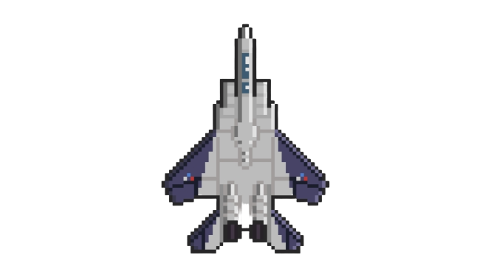
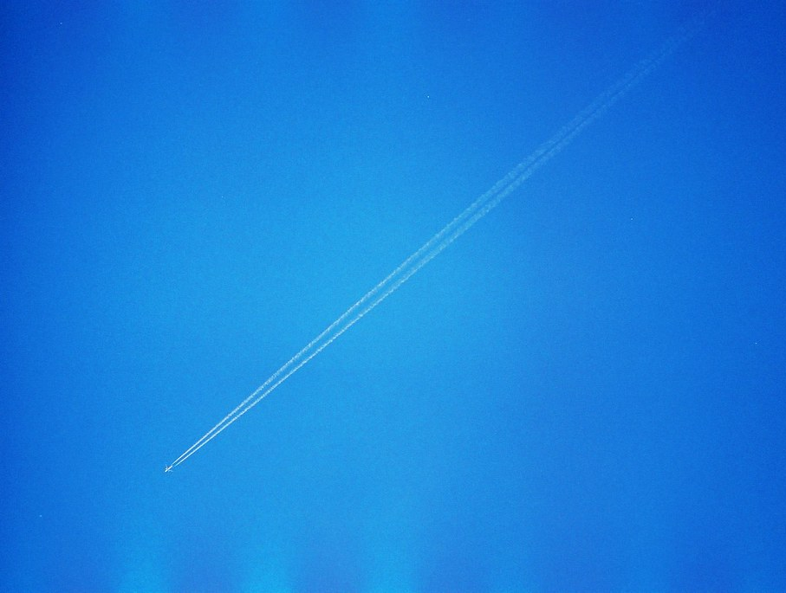
Galaxy Strike
COMP1005
Project Game Design
So Hok Pan (19229895)
此相片 (作者: 未知的作者) 已透過 CC BY 授權

Slide 2
Overview
Scenario
Storyboard
Game Logic

Slide 3

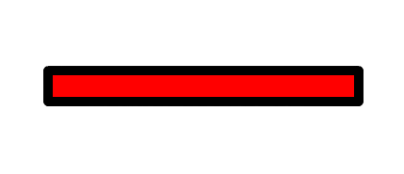


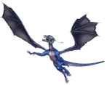
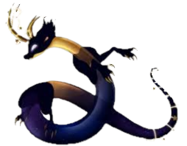
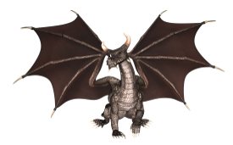
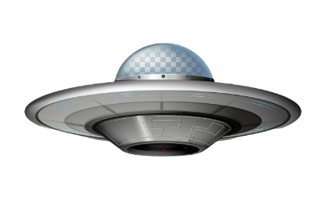
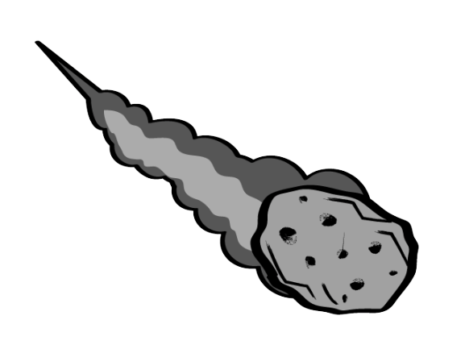

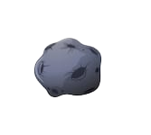
Scenario
Score: 0
Durability:
Our galaxy is invaded by enormous amount of unknown creatures. As a result, it is an urgent matter to choose a capable person to withstand those enemies in order to protect our beautiful galaxy.
You have been chosen as the guardian of the galaxy. During the mission, you will pilot a powerful fighter aircraft to wipe out the invaders. Be careful of the attacks from the invaders and the dangerous aerolites as they will lower the durability of your fighter aircraft. Once the durability of your fighter aircraft becomes zero, the mission fails.
此相片 (作者: 未知的作者) 已透過 CC BY-SA 授權
此相片 (作者: 未知的作者) 已透過 CC BY 授權

Slide 4


Storyboard
Galaxy Strike
Main Menu
Display the name of the game
Display the main character of the game
Draw the scenario page after any key pressed by player
Press any key to start the game !

Slide 5

Storyboard
Scenario
Scenario page
Display the scenario of the game
Draw the game instructions page after the player clicks the CONTINUE button
Our galaxy is invaded by unknown creatures !
You have been chosen as the guardian of the galaxy.
During the mission, you will pilot a fighter aircraft to wipe out enemies.
Look forward to your good news !

Slide 6


Storyboard
Instructions
Control the directions of the fighter aircraft by pressing the arrow keys
Press the SPACE button to attack enemies
Earning marks by defeating enemies, destroying aerolites or evading the aerolites
Once the fighter aircraft is hit by enemies or aerolites, durability decreases.
When the durability becomes zero, the mission fails
Pause the game at any time by clicking the button
Game Instructions Page
Display instructions of the game
Start the game after the player clicks the PLAY button

Slide 7



Storyboard
Score: 0
Durability:
The fighter aircraft is at rest at the lower half of the window initially
Display 0 score at the left-hand corner
Display durability using a red health bar below the score
Display the button at the right-hand corner

Slide 8


Storyboard
Score: 15
Durability:
The fighter aircraft moves when the player presses the arrow keys
The enemies and aerolites appear at random positions in the upper half of the window
The fighter aircraft deploys laser attack when the player presses the SPACE button
Whenever the fighter aircraft evades an aerolite, 5 marks will be added into the score
Whenever the fighter aircraft wipes out an enemy or destroys an aerolite, 10 marks will be added into the score

Slide 9


Storyboard
Score: 15
Durability:
When the fighter aircraft is attacked by enemies or aerolites, the durability decreases which lowers the length of the health bar
If the durability becomes zero (The health bar disappears)
The enemies and aerolites stop moving
The game is over
Display “Mission fails” message
Display the RESTART button
Display the EXIT button
Mission fails

Slide 10
Storyboard
Instructions
Control the directions of the fighter aircraft by pressing the arrow keys
Press the Space button to attack enemies
Earning marks by defeating enemies, shooting down aerolites or evading the aerolites
Once the fighter aircraft is hit by enemies or aerolites, durability decreases.
When the durability becomes zero, the mission fails
Pause the game at any time by clicking the button
After the RESTART button is clicked by the player, the game restarts
Display the game instructions page

Slide 11
Storyboard
Score: 15
Durability:
After the EXIT button is clicked by the player, the game exits
Game window is closed
Mission fails

Slide 12


Storyboard
Score: 15
Durability:
Game Paused
If the button is clicked by the player in the middle of the game
Display “Game Paused” message
Display the RESUME button
Display the RESTART button
Display the EXIT button

Slide 13
Game Logic
Main Menu
Click the CONTINUE button
Press any key?
Game Instructions
Click the PLAY button
No
Yes
Scenario
Yes
Click RESTART button?
No
Click RESUME button?
If Pause button is clicked
If EXIT button is clicked
No
cannot evade the attacks from enemies
Yes
Mission fails
If durability becomes zero
Decrease durability
No
Evade an aerolite?
Yes
No
Enemies and aerolites appear at random positions and start attacking
Yes
The fighter aircraft is at rest
Click RESTART
button?
No
Click EXIT button?
Add 5 marks
Add 10 marks
Press SPACE button?
No
Yes
Yes
If an enemy is defeated or an aerolite is destroyed
The fighter aircraft deploys laser attack
No
Exit the game
The fighter aircraft does not attack
Press any arrow keys?
Yes
The fighter aircraft moves

Slide 14
References
Galaxian. In Wikipedia, The Free Encyclopedia.
Retrieved from https://en.wikipedia.org/wiki/Galaxian

